Slide 1
SMART EDUCATION – PSCS_04
PIP2001 Capstone Project
Final Review
Batch Number: CSE-G112
Under the Supervision of,
Dr. SukruthGowda M A
Assistant Professor
School of Computer Science & Engineering
Presidency University
Roll Number | Student Name
20211CSE0082 | Anandhu Pradeep
20211CSE0062 | N Sai Dinesh
20211CSE0180 | Galiveeti Tharun reddy
20211CSE0433 | Sathya Sree E
Name of the Program: COMPUTER SCIENCE AND ENGINEERING
Name of the HoD: Dr.Asif Mohammed
Name of the Program Project Coordinator: Mr.Amarnath J L, Dr. Jayanthi Kamalasekaran
Name of the School Project Coordinators: Dr. Sampath A K / Dr. Abdul Khadar A / Mr. Md Ziaur Rahman

Slide 2
Introduction
Objective:
Children’s rights are fundamental for their protection, education, and well-being. However, many children are unaware of their rights due to:
Lack of legal education in school curriculums
Complexity of legal language, making it difficult for young minds to understand
Traditional learning methods that are text-heavy and unengaging
Without awareness, children are more vulnerable to exploitation, discrimination, and abuse, as they do not recognize when their rights are being violated.
Solution:
This project introduces a Gamified Platform on Children's Rights, designed to educate children through interactive and engaging learning methods. By integrating game-based learning, we ensure: ✅ Higher engagement through interactive activities ✅ Better retention of legal concepts ✅ Practical understanding of rights in real-life scenarios

Slide 3
Literature Review
Gamification in Education:
Studies show that game-based learning improves engagement and retention
Platforms like Kahoot! and UNICEF’s Right Runner have successfully educated children through gamified approaches
Challenges in Legal Education:
Traditional methods (text-based, legal documents) are difficult for children to grasp
Solution: Using interactive games to simplify legal concepts

Slide 4
Existing method Drawback
Limited Engagement – Many platforms rely on quizzes or text-heavy content, making learning less interactive.
Lack of Real-World Scenarios – Most do not simulate real-life situations where children apply their rights.
Not Easily Accessible – Some require specific devices or installations, limiting reach.
Lack of Personalized Learning – Fixed content without adaptive learning based on a child’s understanding.
Limited Game Diversity – Existing tools focus on a single game format, reducing interest over time.

Slide 5
Proposed Method
How Our Platform Works:
Game-Based Learning – Interactive games teach children about their rights in a fun way.
Simple & Accessible – Web-based platform that works on any device.
Real-Life Scenarios – Kids learn by making choices in story-driven situations.
Engaging & Interactive – Uses quizzes, puzzles, and challenges for better retention.
Future Scalability – Can add new games, languages, and AI tutors over time.
Key Features:
User-Friendly Interface – Simple design for young users.
Multiple Game Modules – Covers different rights like education, protection, and equality.
Audio & Visual Aids – Ensures an immersive learning experience.
Feedback & Progress Tracking – Helps kids understand their learning journey.
Collaboration with Schools & NGOs – Expands reach and impact.

Slide 6
Objectives
Improve children's awareness of their rights through interactive learning
Make legal education engaging using game-based methods
Foster critical thinking through real-world scenarios
Empower children to self-advocate and recognize violations
Ensure accessibility through a web-based platform

Slide 7
Methodology/Modules
Research & Content Development – Identifying key children’s rights and simplifying them into child-friendly lessons
Game Development – Using HTML, CSS, JavaScript for interactive and lightweight gameplay
User Experience (UX) Design – Simple, engaging interface with audio-visual aids
Testing & Feedback – Conducting trials with children and educators to refine content
Deployment & Outreach – Launching as a web-based platform with NGO partnerships

Slide 8
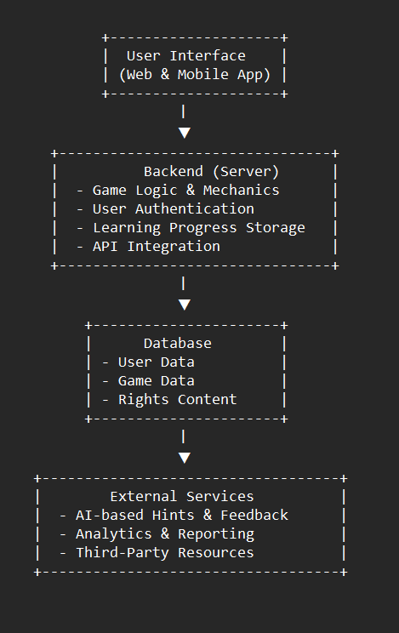
Architecture

Slide 9
Hardware/software components
Technology | Details
Backend | Firebase
Frontend | HTML5\CSS3, javaScript, React.js
Database | Firebase
Deployment | Firebase
Version Control | GitHub for collaboration and updates

Slide 10
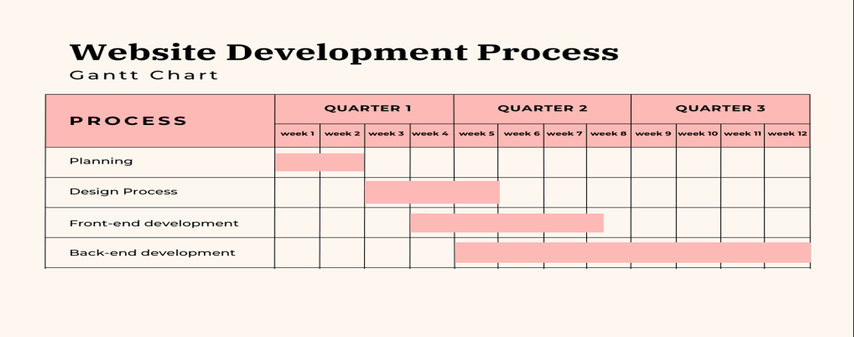
Timeline of Project (Gantt Chart)

Slide 11
Expected Outcomes
Increased Awareness – Children will better understand their rights
Higher Engagement – Game-based learning leads to better retention
Empowerment – Kids learn how to recognize and report violations
Community Impact – Educating children also raises awareness among parents & teachers
Scalability – Future expansions include multilingual support, AI tutors, and more games

Slide 12
Conclusion
Educating children about their rights is crucial for preventing exploitation and discrimination
Gamification provides an interactive and memorable way to teach legal concepts
The platform can scale with more languages, AI integration, and school collaborations
By making children active advocates of their rights, we create a more aware and just society

Slide 13
Github Link
The Github link provided should have public access permission.
Github Link

Slide 14
References
Kahoot! Online Rights Games – Interactive quizzes teaching children about their rights. https://www.unicef.org.uk/rights-respecting-schools/the-rights-runner-game/
UNICEF's Right Runner Game – A mobile game raising awareness on children's rights. https://www.unicef.org/press-releases/right-runner-game
Gamified Learning for Legal Education – Research on gamification for teaching complex topics. https://jetir.org/papers/JETIR2201124.pdf
Human Rights Game – Educational game to teach legal rights and prevent bullying. https://www.humanrightsgame.com
Teaching Expertise: Children's Rights Activities – Educational tools for schools. https://www.teachingexpertise.com/classroom-ideas/childrens-rights-activities

Slide 15
Project work mapping with SDG
Sustainable Development Goal (SDG) | How It Relates to the Project
SDG 4: Quality Education | Provides interactive and accessible learning to educate children about their rights.
SDG 5: Gender Equality | Promotes awareness of equal rights for boys and girls, fostering inclusivity.
SDG 10: Reduced Inequalities | Helps children from diverse backgrounds understand and advocate for their rights.
SDG 16: Peace, Justice & Strong Institutions | Empowers children with knowledge to recognize and report rights violations.

Slide 16
Conclusion…
Thank You

